Slide 1
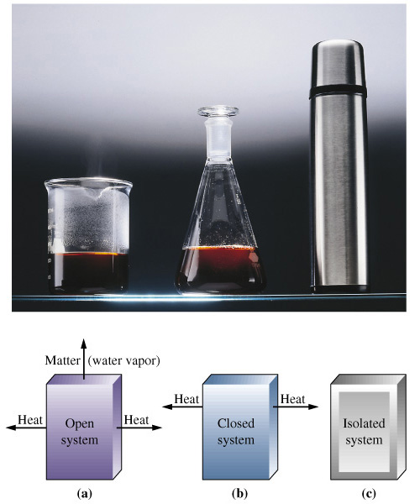
Chapter 7: Thermochemistry
General Chemistry
Principles and Modern Applications
Petrucci • Harwood • Herring
8th Edition
Philip Dutton
University of Windsor, Canada
Prentice-Hall © 2002
Notes:
Thermochemistry branch of chemistry concerned with heat effects accompanying chemical reactions.
Direct and indirect measurement of heat.
Answer practical questions: why is natural gas a better fuel than coal, and why do fats have higher energy value than carbohydrates and protiens.

Slide 2
Contents
7-1 Getting Started: Some Terminology
7-2 Heat
7-3 Heats of Reaction and Calorimetry
7-4 Work
7-5 The First Law of Thermodynamics
7-6 Heats of Reaction: ΔU and ΔH
7-7 The Indirect Determination of ΔH: Hess’s Law

Slide 3
Contents
7-7 The Indirect Determination of ΔH, Hess’s Law
7-8 Standard Enthalpies of Formation
7-9 Fuels as Sources of Energy
Focus on Fats, Carbohydrates, and Energy Storage

Slide 4
6-1 Getting Started: Some Terminology
System
Surroundings

Slide 5
Terminology
Energy, U
  The capacity to do work.
Work
  Force acting through a distance.
Kinetic Energy
  The energy of motion.
Notes:
Energy is from the Greek “work within”.
Moving objects do work when they slow down or are stopped.
Kinetic means “motion” in greek.

Slide 6
Energy
Kinetic Energy
1
kg m²
e_{k} =
mv²
[e_{k} ] =
= J
2
s²
Work
kg m
m
w =
Fd
[w ] =
= J
s²
Notes:
[w] means UNITS OF WORK, not concentration in this case.

Slide 7
Energy
Potential Energy
  Energy due to condition, position, or composition.
  Associated with forces of attraction or repulsion between objects.
Energy can change from potential to kinetic.
Notes:
Energy changes continuously from potential to kinetic.
Energy is lost to the surroundings.

Slide 8
Energy and Temperature
Thermal Energy
  Kinetic energy associated with random molecular motion.
  In general proportional to temperature.
  An intensive property.
Heat and Work
  q and w.
  Energy changes.

Slide 9
Heat
Energy transferred between a system and its surroundings as a result of a temperature difference.
Heat flows from hotter to colder.
  Temperature may change.
  Phase may change (an isothermal process).
Notes:
Heat is transfer of energy. Bodies do NOT contain heat.

Slide 10
Units of Heat
Calorie (cal)
  The quantity of heat required to change the temperature of one gram of water by one degree Celsius.
Joule (J)
  SI unit for heat
1 cal = 4.184 J

Slide 11
Heat Capacity
The quantity of heat required to change the temperature of a system by one degree.
  Molar heat capacity.
    System is one mole of substance.
  Specific heat capacity, c.
    System is one gram of substance
  Heat capacity
    Mass  specific heat.
q =
mcΔT
q =
CΔT

Slide 12
Conservation of Energy
In interactions between a system and its surroundings the total energy remains constant— energy is neither created nor destroyed.
q_{system} + q_{surroundings} = 0
q_{system} = -q_{surroundings}

Slide 13
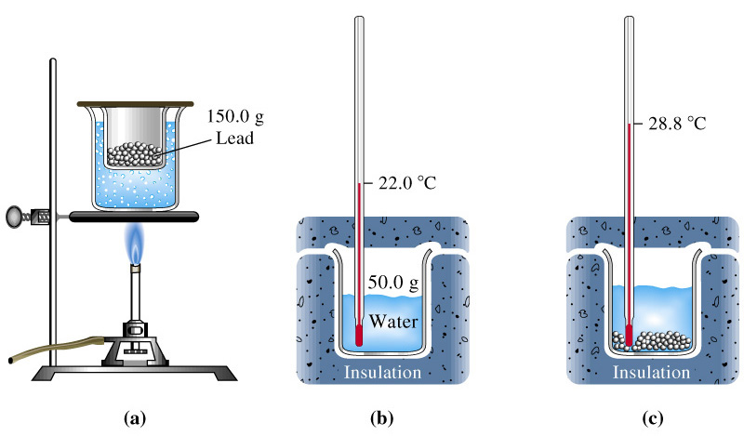
Determination of Specific Heat

Slide 14
Example 7-2
Determining Specific Heat from Experimental Data.
Use the data presented on the last slide to calculate the specific heat of lead.
q_{lead} = -q_{water}
q_{water} = mcΔT = (50.0 g)(4.184 J/g °C)(28.8 - 22.0)°C
q_{water} = 1.4x10³ J
q_{lead} = -1.4x10³ J = mcΔT = (150.0 g)(c)(28.8 - 100.0)°C
c_{lead} = 0.13 Jg⁻¹°C⁻¹

Slide 15
7-3 Heats of Reaction and Calorimetry
Chemical energy.
  Contributes to the internal energy of a system.
Heat of reaction, q_{rxn.}
  The quantity of heat exchanged between a system and its surroundings when a chemical reaction occurs within the system, at constant temperature.
Notes:
In practice, the temperature is allowed to change and the heat that is lost or needed as the system returns to its original temperature is calculated.

Slide 16
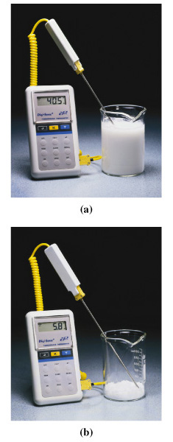
Heats of Reaction
Exothermic reactions.
  Produces heat, q_{rxn} < 0.
Endothermic reactions.
  Consumes heat, q_{rxn} > 0.
Calorimeter
  A device for measuring quantities of heat.
Notes:
Heat of reaction in an isolated system produces a change in the thermal energy of the system. The causes a temperature change.
In an non-isolated system the temperature remains constant and the heat is transferred to the surroundings.
Top picture is CaO(s) + H₂O(l) → Ca(OH)₂
Bottome picture is Ba(OH)₂·8H₂O + 2NH₄Cl(s)→BaCl₂(s) + 2 NH₃(aq) + 8 H₂O(l)

Slide 17
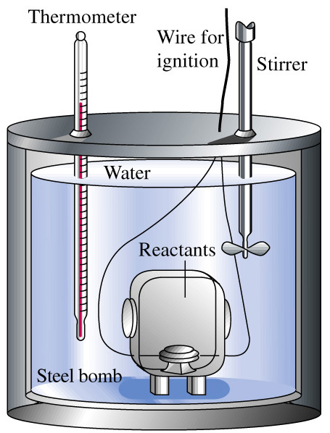
Bomb Calorimeter
q_{rxn} = -q_{cal}
q_{cal} = q_{bomb} + q_{water} + q_{wires} +…
Define the heat capacity of the calorimeter:
q_{cal} = m_{i}c_{i}ΔT = CΔT
heat
all i
Notes:
System includes everything inside the double walled container. All the water, wires, stirrer, thermometer, and the reaction chamber.
Bomb is filled with sample and assembled. Then pressurized witih O₂. A short pulse of electric current heats the sample and ignites it. The final temperature of the calorimeter assembly is determined after the combustion reaction.
Because the reaction is carried out at a fixed volume we say that this is at constant volume.

Slide 18
Example 7-3
Using Bomb Calorimetry Data to Determine a Heat of Reaction.
The combustion of 1.010 g sucrose, in a bomb calorimeter, causes the temperature to rise from 24.92 to 28.33°C. The heat capacity of the calorimeter assembly is 4.90 kJ/°C.
What is the heat of combustion of sucrose, expressed in kJ/mol C₁₂H₂₂O₁₁
Verify the claim of sugar producers that one teaspoon of sugar (about 4.8 g) contains only 19 calories.

Slide 19
Example 7-3
Example 7-3
Calculate q_{calorimeter}:
q_{cal} = CΔT = (4.90 kJ/°C)(28.33-24.92)°C = (4.90)(3.41) kJ
= 16.7 kJ
Calculate q_{rxn}:
q_{rxn} = -q_{cal} = -16.7 kJ
per 1.010 g

Slide 20
Example 7-3
Example 7-3
Calculate q_{rxn} in the required units:
-16.7 kJ
q_{rxn} = -q_{cal} =
= -16.5 kJ/g
1.010 g
343.3 g
q_{rxn}
= -16.5 kJ/g
1.00 mol
= -5.65  10³ kJ/mol
(a)
Calculate q_{rxn} for one teaspoon:
4.8 g
1.00 cal
q_{rxn}
= (-16.5 kJ/g)(
)(
)= -19 cal/tsp
(b)
1 tsp
4.184 J

Slide 21
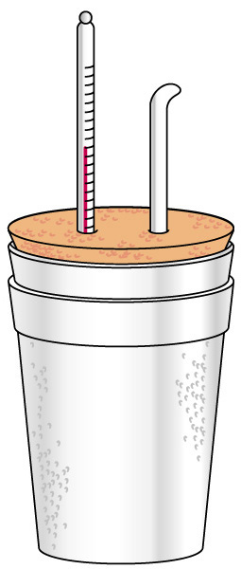
Coffee Cup Calorimeter
A simple calorimeter.
  Well insulated and therefore isolated.
  Measure temperature change.
q_{rxn} = -q_{cal}
See example 7-4 for a sample calculation.

Slide 22
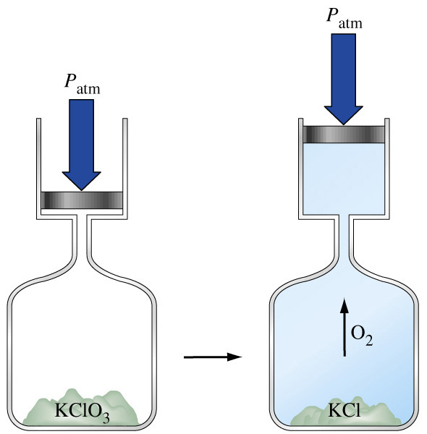
7-4 Work
In addition to heat effects chemical reactions may also do work.
Gas formed pushes against the atmosphere.
Volume changes.
Pressure-volume work.

Slide 23
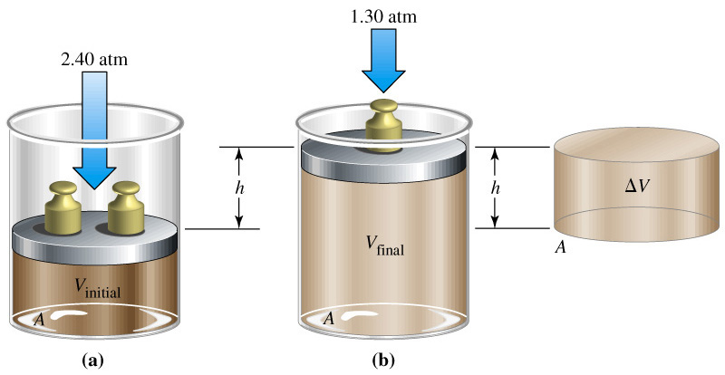
Pressure Volume Work
w = F  d
= (P  A)  h
= PΔV
w = -P_{ext}ΔV
Notes:
Negative sign is introduced for P_{ext} because the system does work ON the surroundings.
When a gas expands ΔV is positive and w is negative.
When a gas is compressed ΔV is negative and w is positive, indicating that energy (as work) enters the system.
In many cases the external pressure is the same as the internal pressure of the system, so P_{ext} is often just represented as P

Slide 24
Example 7-5
Example 7-3
Calculating Pressure-Volume Work.
Suppose the gas in the previous figure is 0.100 mol He at 298 K. How much work, in Joules, is associated with its expansion at constant pressure.
Assume an ideal gas and calculate the volume change:
V_{i} = nRT/P
= (0.100 mol)(0.08201 L atm mol⁻¹ K⁻¹)(298K)/(2.40 atm)
= 1.02 L
V_{f} = 1.88 L
ΔV = 1.88-1.02 L = 0.86 L

Slide 25
Example 7-5
Example 7-3
Calculate the work done by the system:
w = -PΔV
= -(1.30 atm)(0.86 L)(
= -1.1  10² J
Hint: If you use pressure in kPa you get Joules directly.
101 J
)
1 L atm
Where did the conversion factor come from?
Compare two versions of the gas constant and calculate.
8.3145 J/mol K ≡ 0.082057 L atm/mol K
1 ≡ 101.33 J/L atm
Notes:
Note that this conversion factor is simply kPa/atm.

Slide 26
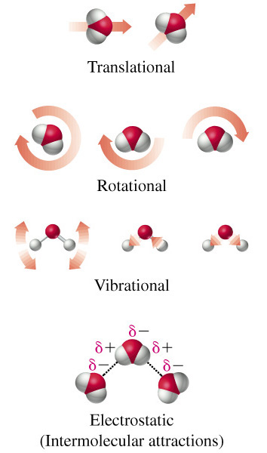
7-5 The First Law of Thermodynamics
Internal Energy, U.
  Total energy (potential and kinetic) in a system.
    Translational kinetic energy.
    Molecular rotation.
    Bond vibration.
    Intermolecular attractions.
    Chemical bonds.
    Electrons.

Slide 27
First Law of Thermodynamics
A system contains only internal energy.
  A system does not contain heat or work.
  These only occur during a change in the system.
Law of Conservation of Energy
  The energy of an isolated system is constant
ΔU = q + w

Slide 28
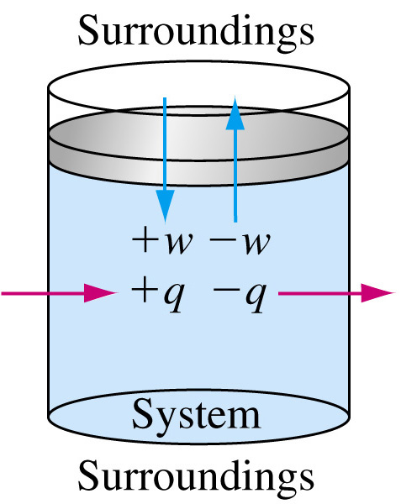
First Law of Thermodynamics

Slide 29
State Functions
Any property that has a unique value for a specified state of a system is said to be a
State Function.
    Water at 293.15 K and 1.00 atm is in a specified state.
    d = 0.99820 g/mL
    This density is a unique function of the state.
    It does not matter how the state was established.

Slide 30
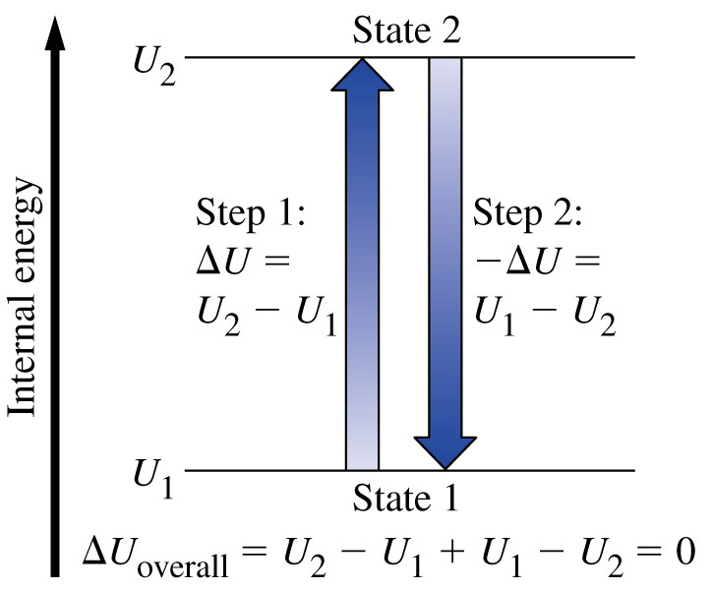
Functions of State
U is a function of state.
  Not easily measured.
ΔU has a unique value between two states.
  Is easily measured.

Slide 31
Path Dependent Functions
Changes in heat and work are not functions of state.
  Remember example 7-5, w = -1.1  10² J in a one step expansion of gas:
  Consider 2.40 atm to 1.80 atm and finally to 1.30 atm.
w = (-1.80 atm)(1.30-1.02)L – (1.30 atm)(1.88-1.36)L
= -0.61 L atm – 0.68 L atm = -1.3 L atm
= 1.3  10² J

Slide 32
7-6 Heats of Reaction: ΔU and ΔH
Reactants → Products
U_{i} U_{f}
ΔU = U_{f} - U_{i}
ΔU = q_{rxn} + w
In a system at constant volume:
ΔU = q_{rxn} + 0 = q_{rxn} = q_{v}
But we live in a constant pressure world!
How does q_{p} relate to q_{v}?

Slide 33
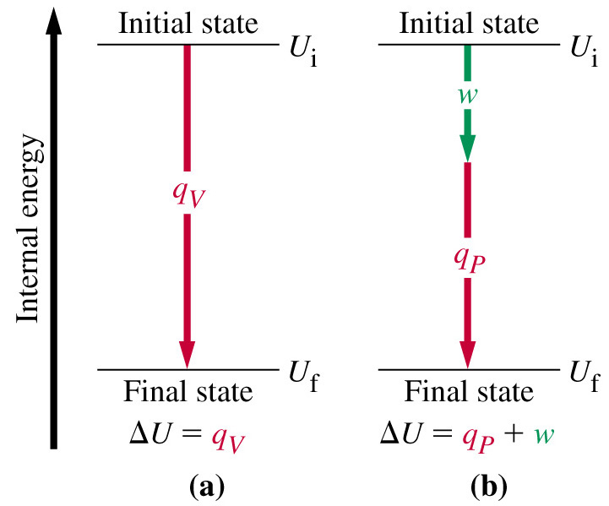
Heats of Reaction

Slide 34
Heats of Reaction
q_{V} = q_{P} + w
We know that w = - PΔV and ΔU = q_{P}, therefore:
ΔU = q_{P} - PΔV
q_{P} = ΔU + PΔV
These are all state functions, so define a new function.
Let H = U + PV
Then ΔH = H_{f} – H_{i} = ΔU + ΔPV
If we work at constant pressure and temperature:
ΔH = ΔU + PΔV = q_{P}

Slide 35
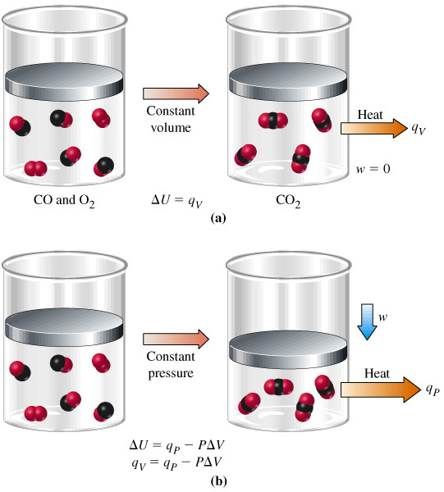
Comparing Heats of Reaction
q_{P} = -566 kJ/mol
= ΔH
PΔV = P(V_{f} – V_{i})
= RT(n_{f} – n_{i})
= -2.5 kJ
ΔU = ΔH - PΔV
= -563.5 kJ/mol
= q_{V}

Slide 36
Changes of State of Matter
Molar enthalpy of vaporization:
H₂O (l) → H₂O(g) ΔH = 44.0 kJ at 298 K
Molar enthalpy of fusion:
H₂O (s) → H₂O(l) ΔH = 6.01 kJ at 273.15 K

Slide 37
Example 7-8
Example 7-3
Enthalpy Changes Accompanying Changes in States of Matter.
Calculate ΔH for the process in which 50.0 g of water is converted from liquid at 10.0°C to vapor at 25.0°C.
Break the problem into two steps: Raise the temperature of the liquid first then completely vaporize it. The total enthalpy change is the sum of the changes in each step.
Set up the equation and calculate:
q_{P} = mc_{H2O}ΔT + nΔH_{vap}
50.0 g
= (50.0 g)(4.184 J/g °C)(25.0-10.0)°C +
44.0 kJ/mol
18.0 g/mol
= 3.14 kJ + 122 kJ = 125 kJ

Slide 38
Standard States and Standard Enthalpy Changes
Define a particular state as a standard state.
Standard enthalpy of reaction, ΔH°
  The enthalpy change of a reaction in which all reactants and products are in their standard states.
Standard State
  The pure element or compound at a pressure of 1 bar and at the temperature of interest.
Notes:
Temperature must be specified because ΔH varies with temperature.

Slide 39
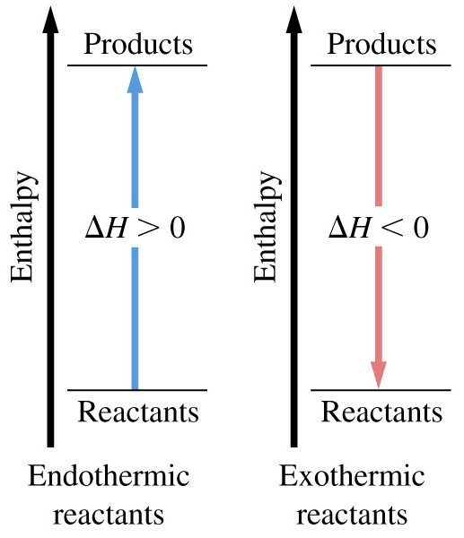
Enthalpy Diagrams

Slide 40
7-7 Indirect Determination of ΔH:
Hess’s Law
ΔH is an extensive property.
  Enthalpy change is directly proportional to the amount of substance in a system.
N₂(g) + O₂(g) → 2 NO(g) ΔH = +180.50 kJ
½N₂(g) + ½O₂(g) → NO(g) ΔH = +90.25 kJ
ΔH changes sign when a process is reversed
NO(g) → ½N₂(g) + ½O₂(g) ΔH = -90.25 kJ

Slide 41
Hess’s Law
Hess’s law of constant heat summation
  If a process occurs in stages or steps (even hypothetically), the enthalpy change for the overall process is the sum of the enthalpy changes for the individual steps.
½N₂(g) + ½O₂(g) → NO(g) ΔH = +90.25 kJ
NO(g) + ½O₂(g) → NO₂(g) ΔH = -57.07 kJ
½N₂(g) + O₂(g) → NO₂(g) ΔH = +33.18 kJ

Slide 42
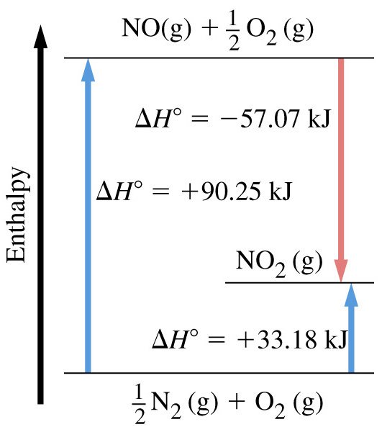
Hess’s Law Schematically

Slide 43
7-8 Standard Enthalpies of Formation
ΔH_{f}°
The enthalpy change that occurs in the formation of one mole of a substance in the standard state from the reference forms of the elements in their standard states.
The standard enthalpy of formation of a pure element in its reference state is 0.
Notes:
Absolute enthalpy cannot be determined.
H is a state function so changes in enthalpy, ΔH, have unique values.
Reference forms of the elements in their standard states are the most stable form of the element at one bar and the given temperature.
The superscript degree symbol denotes that the enthalpy change is a standard enthalpy change and
The subscript “f” signifies that the reaction is one in which a substance is formed from its elements.

Slide 44
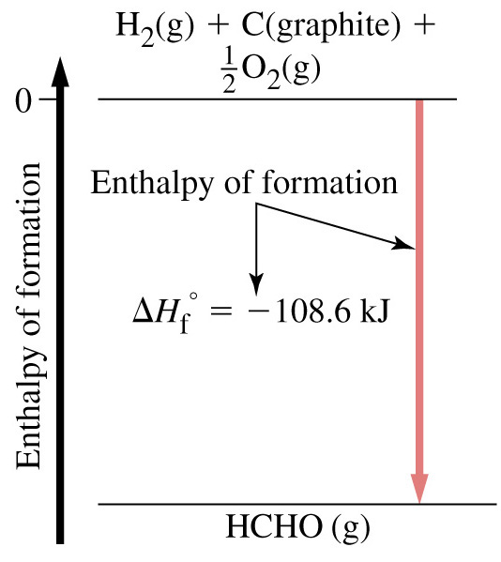
Standard Enthalpies of Formation

Slide 45
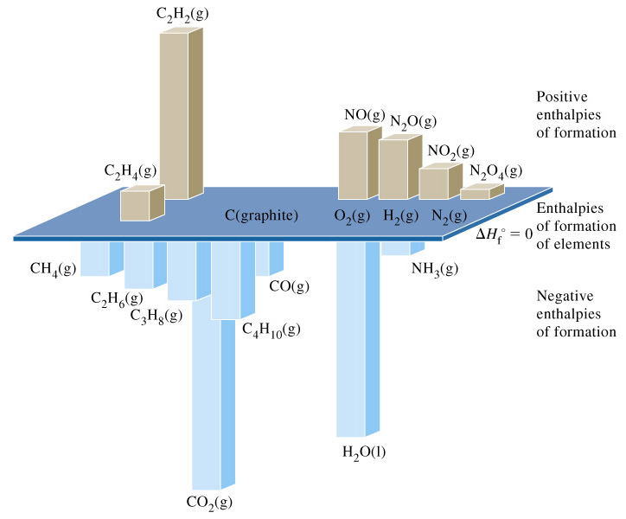
Standard Enthalpies of Formation

Slide 46
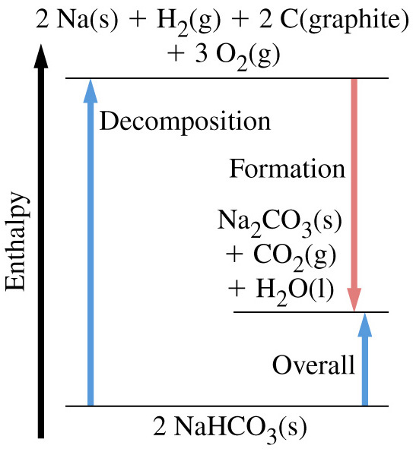
Standard Enthalpies of Reaction
ΔH_{overall} = -2ΔH_{f}°_{NaHCO3}+ ΔH_{f}°_{Na2CO3}
+ ΔH_{f}°_{CO2} + ΔH_{f}°_{H2O}

Slide 47
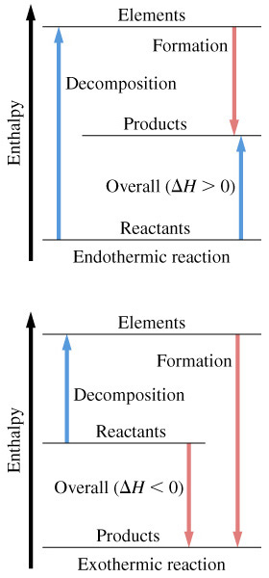
Enthalpy of Reaction
ΔH_{rxn} = ΔH_{f}°_{products}- ΔH_{f}°_{reactants}

Slide 48
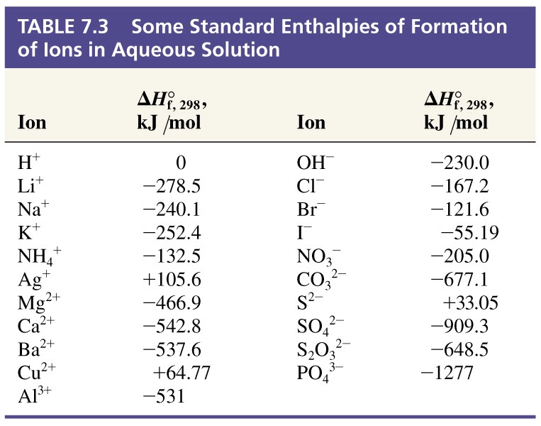
Table 7.3 Enthalpies of Formation of Ions in Aqueous Solutions

Slide 49
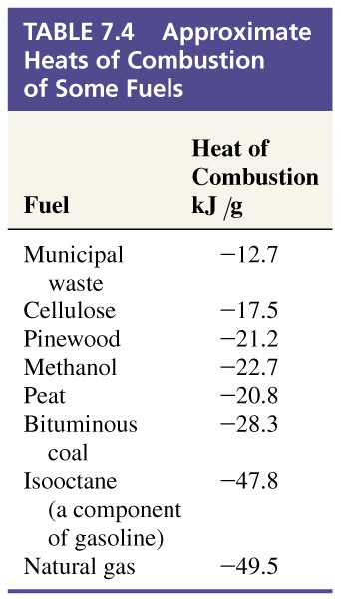
7-9 Fuels as Sources of Energy
Fossil fuels.
  Combustion is exothermic.
  Non-renewable resource.
  Environmental impact.

Slide 50
Chapter 7 Questions
1, 2, 3, 11, 14, 16, 22, 24, 29, 37, 49, 52, 63, 67, 73, 81

